Slide 1
Tunneling
Tunneling refers to a method of encapsulating one network protocol within another network protocol.
This technique allows data to be transmitted securely across a public network by creating a private, encrypted connection between two endpoints.
Encapsulation: Tunneling involves wrapping a packet of data from one protocol within the payload of another protocol. This outer protocol creates a tunnel through which the inner protocol's packets can travel.
Purpose: Tunneling is used primarily for two main purposes:
Security: It provides a way to create secure connections over an insecure network, such as the internet. By encapsulating data in a tunnel, sensitive information is protected from eavesdropping and tampering.
Compatibility: It enables networks that use different protocols or technologies to communicate with each other. Tunneling allows for interoperability between networks that may not natively support each other's protocols.

Slide 2
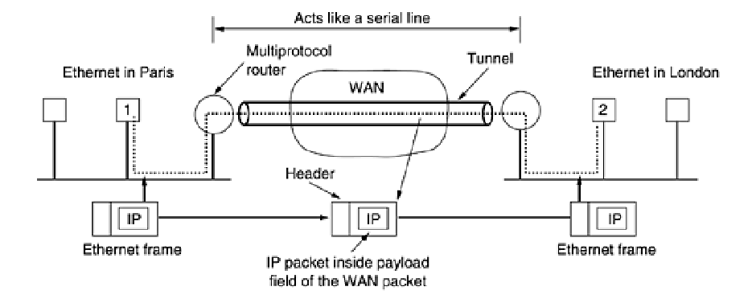
Tunneling

Slide 3
Tunneling
As an example, think of an international bank with a TCP/IP-based Ethernet in Paris, a TCP/IP-based Ethernet in London, and a non-IP wide area network (e.g., ATM) in between. The solution to this problem is a technique called tunneling.
To send an IP packet to host 2, host 1 constructs the packet containing the IP address of host 2, inserts it into an Ethernet frame addressed to the Paris multiprotocol router, and puts it on the Ethernet.
When the multiprotocol router gets the frame, it removes the IP packet, inserts it in the payload field of the WAN network layer packet, and addresses the latter to the WAN address of the London multiprotocol router. When it gets there, the London router removes the IP packet and sends it to host 2 inside an Ethernet frame.
The WAN can be seen as a big tunnel extending from one multiprotocol router to the other. The IP packet just travels from one end of the tunnel to the other, snug in its nice box.
It does not have to worry about dealing with the WAN at all. Neither do the hosts on either Ethernet. Only the multiprotocol router has to understand IP and WAN packets. In effect, the entire distance from the middle of one multiprotocol router to the middle of the other acts like a serial line.

Slide 4
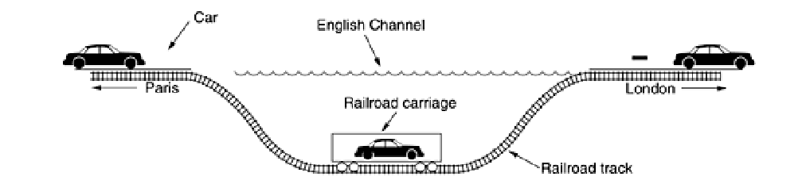
Tunneling- Car

Slide 5
Tunneling
Types of Tunnels: There are several types of tunnels commonly used in networking:
VPN Tunnels: Virtual Private Network (VPN) tunnels are perhaps the most well-known type. They create secure, encrypted connections between remote users or networks and a central server, allowing remote access to private resources.
IPsec Tunnels: IPsec (Internet Protocol Security) tunnels are used to secure communications at the IP layer by authenticating and encrypting IP packets.
GRE Tunnels: Generic Routing Encapsulation (GRE) tunnels are used to encapsulate any network layer protocol over an IP network.
SSH Tunnels: Secure Shell (SSH) tunnels are used to encrypt and forward traffic between a local and remote host.
Implementation: Tunneling can be implemented at different layers of the networking stack, such as at the data link layer (e.g., Ethernet over GRE) or at the network layer (e.g., IP over IPsec).
Examples: Organizations use tunneling extensively for secure remote access, site-to-site connectivity, and integrating different network technologies. For instance, a company might use VPN tunnels to connect branch offices securely over the internet or to allow remote employees to access corporate resources securely.
Overall, tunneling in networks is a powerful technique that enhances both security and interoperability by encapsulating data within another protocol, thereby enabling safe and efficient communication across diverse network environments.

Slide 6
Tunneling-Limitations
Performance Overhead: Encrypting and encapsulating data adds processing overhead and can impact network performance, especially in high-traffic scenarios. The additional complexity of tunneling protocols can also increase latency.
Compatibility Issues: Implementing and maintaining tunnels between networks with different protocols or configurations can be complex. Compatibility issues may arise, requiring careful configuration and management to ensure seamless operation.
Potential Security Risks: While tunneling enhances security by encrypting data, improperly configured tunnels or vulnerabilities in tunneling protocols can introduce security risks. It's essential to implement robust security measures and stay updated with patches and updates.
Scalability: Managing and scaling tunneling solutions across large networks or a growing number of remote users can be challenging. It requires careful planning and resource allocation to ensure optimal performance and security.
Regulatory and Compliance Considerations: Organizations must comply with regulatory requirements and data protection laws when implementing tunneling solutions, especially concerning data privacy and cross-border data transfers.
In summary, tunneling provides significant benefits in terms of security, interoperability, and remote access capabilities. However, it also requires careful consideration of performance impacts, security risks, and operational complexities to ensure effective deployment and management in network environments.
.

Slide 7
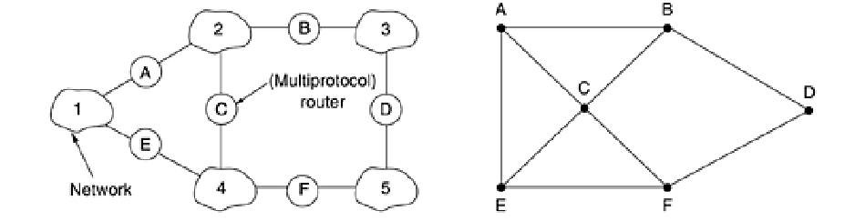
Internetwork Routing
Routing through an internetwork is similar to routing within a single subnet, but with some added complications.
Consider, for example, the internetwork in which five networks are connected by six (possibly multiprotocol) routers. Making a graph model of this situation is complicated by the fact that every router can directly access (i.e., send packets to) every other router connected to any network to which it is connected.
For example, B in Fig can directly access A and C via network 2 and also D via network 3. This leads to the graph of Figure.

Slide 8
Internetwork Routing
Once the graph has been constructed, known routing algorithms, such as the distance vector and link state algorithms, can be applied to the set of multiprotocol routers.
This gives a two level routing algorithm: within each network an interior gateway protocol is used, but between the networks, an exterior gateway protocol is used (''gateway'' is an older term for “router'').
In fact, since each network is independent, they may all use different algorithms. Because each network in an internetwork is independent of all the others, it is often referred to as an Autonomous System (AS).
A typical internet packet starts out on its LAN addressed to the local multiprotocol router (in the MAC layer header).
After it gets there, the network layer code decides which multiprotocol router to forward the packet to, using its own routing tables. If that router can be reached using the packet's native network protocol, the packet is forwarded there directly.
Otherwise it is tunneled there, encapsulated in the protocol required by the intervening network. This process is repeated until the packet reaches the destination network.

Slide 9
Internetwork Routing
One of the differences between internetwork routing and intranetwork routing is that internetwork routing may require crossing international boundaries.
Another difference between interior and exterior routing is the cost. Within a single network, a single charging algorithm normally applies.
However, different networks may be under different managements, and one route may be less expensive than another.
Similarly, the quality of service offered by different networks may be different, and this may be a reason to choose one route over another.
Autonomous networks represent a cutting-edge approach to networking where network management tasks are automated and self-managed to a large extent.
Autonomous networks represent a transformative approach to network management, leveraging automation, AI, and advanced analytics to deliver efficient, reliable, and secure connectivity. While facing significant challenges, their potential benefits in terms of efficiency, reliability, and scalability make them a compelling area of development in modern networking paradigms.

Slide 10
Fragmentation
Network Fragmentation:
Definition: Network fragmentation refers to the breaking up of data packets into smaller units during transmission over a network.
Causes: This occurs when data packets are too large to fit into the Maximum Transmission Unit (MTU) of a network segment or when routers along the path between source and destination have different MTU sizes.
Effects: Fragmented packets can increase network latency and reduce network performance because routers must reassemble fragmented packets before forwarding them, which adds processing overhead.
Solution: Path MTU Discovery (PMTUD) is used to dynamically determine the largest packet size that can be transmitted without fragmentation along a given network path. This helps optimize network performance by avoiding unnecessary fragmentation.
In both cases, fragmentation can impact system performance and efficiency. Managing and optimizing storage devices (for file fragmentation) and network configurations (for network fragmentation) are essential for maintaining optimal system and network performance.

Slide 11
Fragmentation
Each network imposes some maximum size on its packets. These limits have various causes, among them:
Hardware (e.g., the size of an Ethernet frame).
2. Operating system (e.g., all buffers are 512 bytes).
3. Protocols (e.g., the number of bits in the packet length field).
4. Compliance with some (inter)national standard.
5. Desire to reduce error-induced retransmissions to some level.
6. Desire to prevent one packet from occupying the channel too long.
The result of all these factors is that the network designers are not free to choose any maximum packet size they wish. Maximum payloads range from 48 bytes (ATM cells) to 65,515 bytes (IP packets), although the payload size in higher layers is often larger.

Slide 12
Fragmentation
Two opposing strategies exist for recombining the fragments back into the original packet.
The first strategy is to make fragmentation caused by a ''small-packet'' network transparent to any subsequent networks through which the packet must pass on its way to the ultimate destination.
This option is shown in Fig. In this approach, the small-packet network has gateways (most likely, specialized routers) that interface to other networks.
When an oversized packet arrives at a gateway, the gateway breaks it up into fragments. Each fragment is addressed to the same exit gateway, where the pieces are recombined.
In this way passage through the small-packet network has been made transparent. Subsequent networks are not even aware that fragmentation has occurred.
ATM networks, for example, have special hardware to provide transparent fragmentation of packets into cells and then reassembly of cells into packets. In the ATM world, fragmentation is called segmentation; the concept is the same, but some of the details are different.

Slide 13
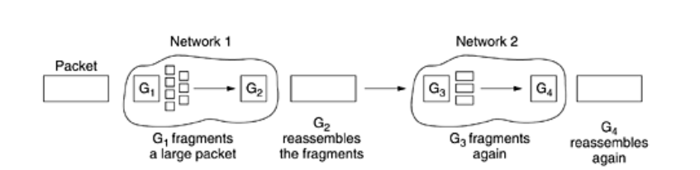
Transparent Fragmentation
Transparent fragmentation refers to a process where the fragmentation of data or processes is managed in such a way that it is invisible or minimally disruptive to users or applications.
Usage: In networking, transparent fragmentation might occur when data packets are broken down into smaller pieces to fit the maximum transmission unit (MTU) size of a network link, but this process is managed by the networking hardware or software without requiring specific handling or reassembly by the end-user application.
Transparent fragmentation is straightforward but has some problems. For one thing, the exit gateway must know when it has received all the pieces, so either a count field or an ''end of packet'' bit must be provided.
For another thing, all packets must exit via the same gateway. By not allowing some fragments to follow one route to the ultimate destination and other fragments a disjoint route, some performance may be lost.
A last problem is the overhead required to repeatedly reassemble and then refragment a large packet passing through a series of small-packet networks. ATM requires transparent fragmentation.

Slide 14
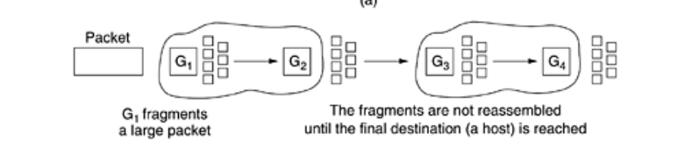
Non-Transparent Fragmentation
Non-transparent fragmentation, on the other hand, involves a process where the fragmentation is apparent or requires explicit management or handling by the user or application.
Usage: In networking, non-transparent fragmentation might occur when data packets are fragmented and must be reassembled by the receiving end of a communication link. This could require additional processing and management by the receiving application or system to reconstruct the original data.
The other fragmentation strategy is to refrain from recombining fragments at any intermediate gateways. Once a packet has been fragmented, each fragment is treated as though it were an original packet.
All fragments are passed through the exit gateway (or gateways), as shown in Fig. Recombination occurs only at the destination host. IP works this way.

Slide 15
Non-Transparent Fragmentation
Non-transparent fragmentation also has some problems. For example, it requires every host to be able to do reassembly. Yet another problem is that when a large packet is fragmented, the total overhead increases because each fragment must have a header.
Whereas in the first method this overhead disappears as soon as the small-packet network is exited, in this method the overhead remains for the rest of the journey. An advantage of non-transparent fragmentation, however, is that multiple exit gateways can now be used and higher performance can be achieved.
When a packet is fragmented, the fragments must be numbered in such a way that the original data stream can be reconstructed. One way of numbering the fragments is to use a tree. If packet 0 must be split up, the pieces are called 0.0, 0.1, 0.2, etc.
If these fragments themselves must be fragmented later on, the pieces are numbered 0.0.0, 0.0.1, 0.0.2, . 0.1.0, 0.1.1, 0.1.2, etc.
If enough fields have been reserved in the header for the worst case and no duplicates are generated anywhere, this scheme is sufficient to ensure that all the pieces can be correctly reassembled at the destination, no matter what order they arrive in.

Slide 16
Non-Transparent Fragmentation
If even one network loses or discards packets, end-to-end retransmissions are needed, with unfortunate effects for the numbering system. Suppose that a 1024-bit packet is initially fragmented into four equal-sized fragments, 0.0, 0.1, 0.2, and 0.3.
Fragment 0.1 is lost, but the other parts arrive at the destination. Eventually, the source times out and retransmits the original packet again.
Only this time Murphy's law strikes and the route taken passes through a network with a 512-bit limit, so two fragments are generated.
When the new fragment 0.1 arrives at the destination, the receiver will think that all four pieces are now accounted for and reconstruct the packet incorrectly.
A completely different (and better) numbering system is for the internetwork protocol to define an elementary fragment size small enough that the elementary fragment can pass through every network. When a packet is fragmented, all the pieces are equal to the elementary fragment size except the last one, which may be shorter.
An internet packet may contain several fragments, for efficiency reasons. The internet header must provide the original packet number and the number of the (first) elementary fragment contained in the packet. As usual, there must also be a bit indicating that the last elementary fragment contained within the internet packet is the last one of the original packet.

Slide 17
Non-Transparent Fragmentation
This approach requires two sequence fields in the internet header: the original packet number and the fragment number.
There is clearly a trade-off between the size of the elementary fragment and the number of bits in the fragment number.
The elementary fragment size is presumed to be acceptable to every network, subsequent fragmentation of an internet packet containing several fragments causes no problem.
The ultimate limit here is to have the elementary fragment be a single bit or byte, with the fragment number then being the bit or byte offset within the original packet.
Some internet protocols take this method even further and consider the entire transmission on a virtual circuit to be one giant packet, so that each fragment contains the absolute byte number of the first byte within the fragment.

Slide 18
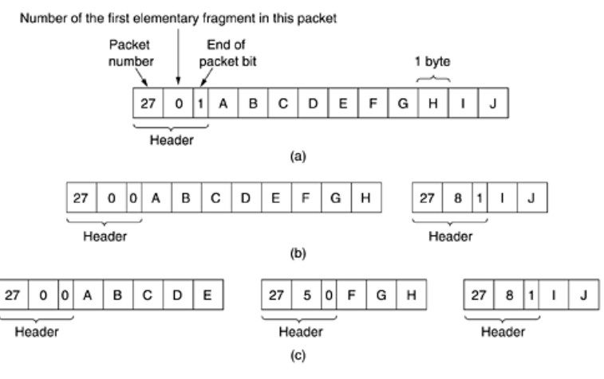
Non-Transparent Fragmentation
Fragmentation when the elementary data size is 1 byte. (a) Original packet, containing 10 data bytes.
(b) Fragments after passing through a network with maximum packet size of 8 payload bytes plus header.
(c) Fragments after passing through a size 5 gateway.

Slide 19
Fragmentation Limitations
Visibility: Transparent fragmentation is managed invisibly or with minimal user intervention, while non-transparent fragmentation requires explicit handling or reassembly.
Impact: Transparent fragmentation tends to have less impact on the user experience or system performance since it is managed at lower layers of the system, whereas non-transparent fragmentation can introduce delays or complexity in data transmission and processing.
In essence, the distinction between transparent and non-transparent fragmentation lies in how visible and manageable the process of breaking down and reassembling data or processes is to the end-user or application.
Fragmentation, when implemented strategically and managed properly, can lead to significant improvements in efficiency, performance, flexibility, and resilience across various computing and networking environments.
Overhead and Complexity:
Management Overhead: Fragmentation can introduce additional complexity and management overhead, especially in systems where fragmented data or resources need to be tracked, managed, and reassembled.
Performance Impact: The process of fragmenting data and later reassembling it can consume system resources (such as CPU cycles and memory), which may degrade overall system performance, especially in resource-constrained environments.

Slide 20
Fragmentation Limitations
Fragmentation Overhead:
Storage Inefficiency: Fragmentation can lead to storage inefficiency when data is stored in non-contiguous segments. This can result in wasted storage space and slower access times, particularly in systems where frequent access to sequential data is necessary.
Data Integrity and Consistency:
Data Consistency: Fragmentation can pose challenges to maintaining data consistency, especially in distributed systems where data segments may be updated independently. Ensuring data integrity and synchronization across fragmented pieces can be complex and may require additional mechanisms.
Network Overhead:
Transmission Overhead: In networking, fragmentation can introduce additional overhead in terms of network bandwidth and latency. Fragmented packets may require additional processing and reassembly at the receiving end, which can impact network performance and delay data transmission.
Fragmentation Fragmentation:
Fragmentation Risks: While fragmentation can optimize resource utilization, excessive fragmentation (fragmentation of fragmentation) can occur if not managed properly. This can lead to further inefficiencies and complications in resource allocation and management.

